Slide 1
Managing Systems Security
Computer Systems Management
Module Code CT012-3-3
Level 3
VD1

Slide 2
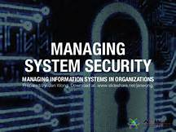
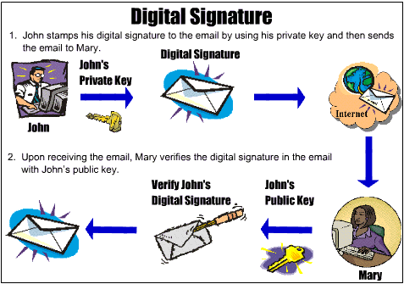
Learning Outcomes
Risk Management
Security Policy
Security Solutions

Slide 3
Content
Risk Management
Establishing a Security Policy
Digital Certificate
Steganography
Digital Security

Slide 4
Key Terms
Digital Certificate
Digital Security

Slide 5
Risk Management
Internet
  Not designed to be secure
  Designed to provide redundancy
Message Traveling on the Internet
  Subject to secrecy, integrity and necessity threats
Electronic Threat
  Impostors, eavesdroppers, thieves
  Eavesdropper (person or device) that listens and copies Internet transmissions

Slide 6
Risk Management
Risk Management - practice of identifying
potential risks in computer systems, analyzing them and taking precautionary steps
Risk Management Model - Four general organizational actions based on
    - Impact (cost) and probability of physical threat

Slide 7
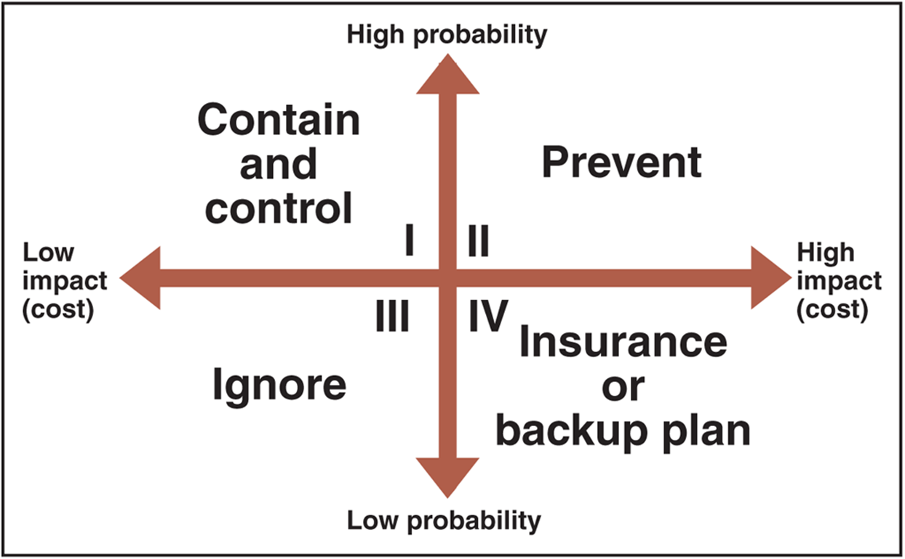
Risk Management
Risk Management Model

Slide 8
Risk Management
Low probability of occurrence - threats that
are unlikely to occur
Can be ignored when cost of protection against the threats exceeds value of the protected asset
Example: Cities in the U.S.
  Computer systems need to be protected from frequent tornadoes in Oklahoma
  However, a similar computer system in Maine would not require the same protection as tornadoes are extremely rare
  Tornadoes in Oklahoma would be in quadrant II
  Tornadoes in Maine would be in quadrant IV

Slide 9
Establishing a Security Policy
Security Policy Goals
  Protect privacy, integrity and availability
  Authenticate users
Security Policy Elements
  Assets to protect and why
  Protection responsibility
  Acceptable and unacceptable behaviors
  Physical and network security, access authorizations, virus protection, disaster recovery

Slide 10
Establishing a Security Policy
Corporate Information Classifications
  Public
  Company confidential
Steps to Create Security Policy
  Determine which assets to protect from which threats
  Determine access needs to various system parts
  Identify resources to protect assets
  Develop written security policy
  Commit resources

Slide 11
Digital Certificate
Digital Certificate (Digital ID)
  Signed message or code that provides proof of holder identified by the certificate
  E-mail message attachment or program embedded in Web page. Verifies sender or Web site
  A means to send encrypted message
  Digital certificates cannot be forged easily
  Used for online transactions:
    E-Commerce, E-mail, electronic funds transfers
  Six main elements: owner’s identifying information, owner’s public key, dates certificate is valid, serial number, issuer name, issuer digital signature

Slide 12
Digital Certificate
Certification Authority (CA) - issues digital certificates to organizations, individuals
  Requires applicants to supply proof of identity
  CA issues and signs the certificate. CA’s stamp of approval is via a public encryption key
  Key is a binary number used with the encryption algorithm to lock the characters of the message so that its undecipherable without the key
  Public encryption key unlocks the certificate for anyone who receives the certificate attached to the publisher’s code

Slide 13
Steganography
Steganography - hiding information within
another piece of information
Can be used for malicious purposes
Hiding encrypted file within another file
  Casual observer cannot detect anything of importance in container file
  Two-step process
    Encrypting file protects it from being read
    Steganography makes it invisible

Slide 14
Security for Client Devices
New Physical Security Technologies
  Fingerprint readers
    Stronger protection than password
Biometric Security Device
  Identification using person’s biological makeup
  Examples: signature recognition, eye scanners, palm scanners, reading back of hand vein pattern

Slide 15
Encryption Solution
Encryption - coding information using
mathematically based program, secret key
Encryption Algorithm - logic behind encryption program
Encryption Program - transforms normal text (plain text) into cipher text (unintelligible characters string)
Decryption Program - message is decoded or decrypted
Cryptography - science of creating messages
only sender and receiver can read. Converts text to other visible text with no meaning

Slide 16
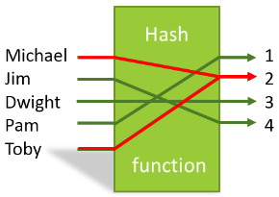
Hash Coding
Hash Coding - process uses hash algorithm
Calculates number (hash value) from any message length
Unique message fingerprint
Can be used to determine if message has been altered during transit
  Mismatch between original hash value and receiver computed value

Slide 17
Secure Sockets Layer (SSL) Protocol
Provides security “handshake”. Client and
server exchange brief burst of messages
All communication encrypted
Secures different communication types: HTTP, FTP,
HTTPS: protocol implementing SSL
Encrypted transaction generates private session key
  Bit lengths vary (examples: 128-bit, 256-bit)
Session key - creates cipher text from plain text during single secure session
Secrecy implemented using combination of public-key and private-key encryption

Slide 18
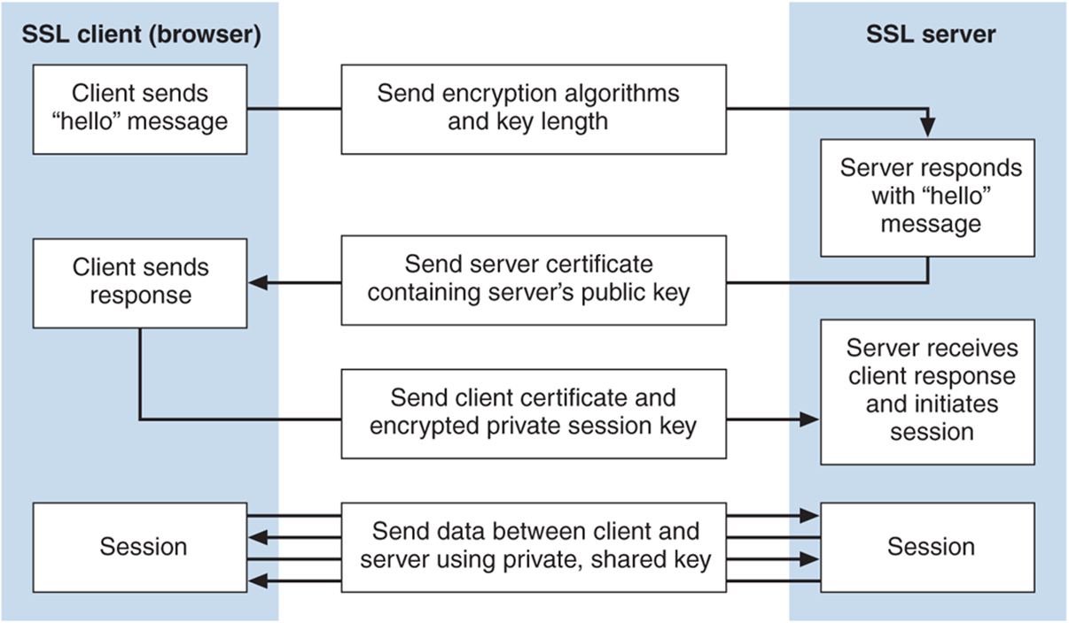
Secure Sockets Layer (SSL) Protocol

Slide 19
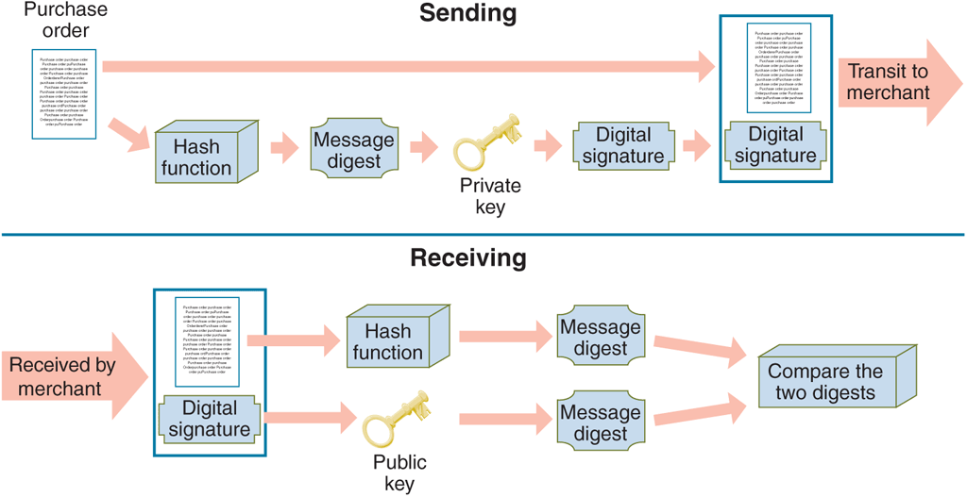
Digital Signature
Digital Signature - encrypted message
created using a private key, providing:
  Nonrepudiation
  Positive identification of the sender
  Secrecy when used with an encrypted message
  Same legal status as traditional written signature

Slide 20
Access Control, Audit Trail and Intrusion Detection Software
Intrusion Detection Software - analyzes
network traffic, assesses system vulnerabilities and identifies intrusions and suspicious behavior
2. Access Control - defines who can access computer and what actions they can take
Audit Trail - records access attempts

Slide 21
Firewall
Firewall - Software, hardware-software combination
  Installed in a network to control packet traffic
Placed at Internet entry point of network, defence
  between network and the Internet
  between network and any other network
Principles
  All traffic must pass through it
  Only authorized traffic allowed to pass
  Immune to penetration

Slide 22
Organizations that Promote Computer Security
1. CERIAS (Center for Education and Research in Information Assurance and Security)
  Multidisciplinary information security research and education
2. CERT - Computer Emergency Response Team
Housed at Carnegie Mellon University
  Software Engineering Institute
Maintains effective, quick communications infrastructure among security experts
Primary authoritative source for viruses, worms and other types of attack information

Slide 23
Computer Forensics and Ethical Hacking
Computer Forensics Experts (Ethical Hackers)
  Computer sleuths hired to probe PCs
  Locate information usable in legal proceedings
  Job of breaking into client computers
  Companies hire ethical hackers to test computer security safeguards
Computer Forensics
  Responsible for collection, preservation, and computer-related evidence analysis in crime investigation

Slide 24
Summary
Question and Answer Session
Risk Management - practice of identifying potential risks in computer systems, analyzing them and taking precautionary steps
Security Policy - protect privacy, integrity and availability. Authenticate users

Slide 25
Review Questions
Question and Answer Session
Explain Security Policy
Describe some of the new physical security technologies

Slide 26

Question and Answer Session
Question and Answer Session
Q & A

Slide 27
What We will Cover Next
Question and Answer Session
Disaster Recovery

